Slide 1
Do you want to be a dental professional?
UCLA Community Oral Health Program
Module 13: Careers in Dentistry
Dentist, Dental Hygienist, Dental Assistant, and much more!

Slide 2
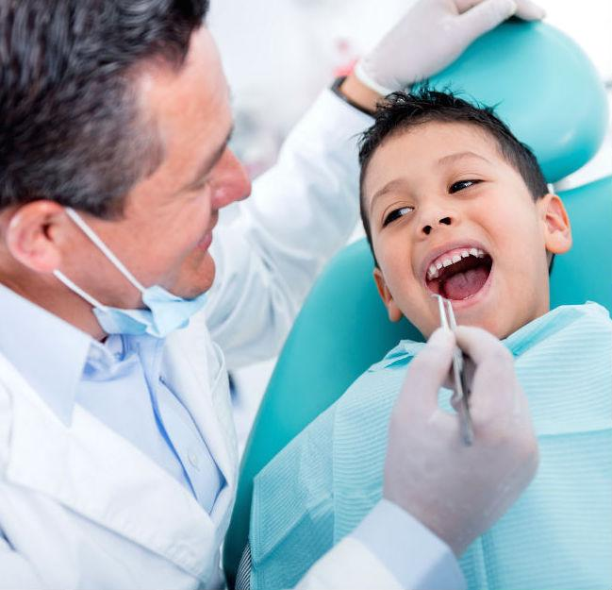
Dentist
4 years college: BS or BA
4 years: DDS/DMD (General Dentistry)
1 to 3 years: Specialization (optional)
UCLA Community Oral Health Program
Module 13: Careers in Dentistry

Slide 3
Duties of Dentist
Diagnosing oral diseases.
Promoting oral health and disease prevention.
Creating treatment plans to maintain or restore the oral health of their patients.
Interpreting x-rays and diagnostic tests.
Ensuring the safe administration of anesthetics.
Monitoring growth and development of the teeth and jaws.
Performing surgical procedures on the teeth, bone and soft tissues of the oral cavity.
UCLA Community Oral Health Program
Module 13: Careers in Dentistry

Slide 4
Steps to DDS
Step 1: Enroll in a Bachelor's Degree Program. Dental schools generally require applicants to hold bachelor's degrees before gaining admission
Step 2: Take the Dental Admission Test.
Step 3: Earn a Dental Degree.
Step 4: Obtain Licensure.
Step 5: Consider a Specialization or start Practicing.
UCLA Community Oral Health Program
Module 13: Careers in Dentistry

Slide 5
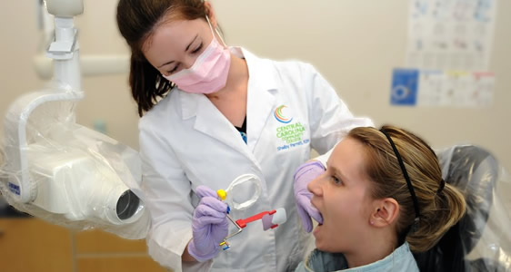
Dental Assistant
UCLA Community Oral Health Program
Module 13: Careers in Dentistry

Slide 6
Options you have for being a dental assistant
Dental Assistant (DA)
9-12 month program at a community college or technical school or
Gain work experience with a licensed dentist in the US
Registered Dental Assistant (RDA)
Licensed with the state of California to perform more duties than a dental assistant
Higher pay than a DA
Registered Dental Assistant w/ Extended Functions (RDAEF)
Requires additional education after completing an RDA program
Must take board exams to be certified in extended functions
Higher pay than an RDA
UCLA Community Oral Health Program
Module 13: Careers in Dentistry

Slide 7
Duties of a Registered dental assistant
Registered dental assistants work alongside dentists to provide dental care for patients.
Some patient-care tasks include
Setting up operatory rooms and sterilizing instruments
Preparing the patient for treatment
Handing instruments to the dentist
Educating patients on proper dental care.
Other duties include
Taking and processing x-rays
Making teeth casts, temporary crowns, and other lab work as needed.
UCLA Community Oral Health Program
Module 13: Careers in Dentistry

Slide 8
Steps to become an RDA
Enroll in a Board-Approved RDA educational program
Many community colleges offer a 12-month RDA program.
www.dbc.ca.gov has a list of approved RDA programs.
Complete courses in coronal polishing and sealants
Most of the time included in an RDA Program.
Allows a dental assisting to perform more duties
Take board-exam to obtain licensure
Written and Practical Exams
UCLA Community Oral Health Program
Module 13: Careers in Dentistry
Notes:
Make more simple!

Slide 9
Registered dental hygienist
UCLA Community Oral Health Program
Module 13: Careers in Dentistry

Slide 10
What is a dental hygienist?
A licensed professional who educates patients on ways to improve and maintain good oral health. Alongside a dentist, dental hygienists examine patients for signs of oral diseases and provided preventative care.
For more info visit: the American Dental Hygienist Association website at: http://www.adha.org/
UCLA Community Oral Health Program
Module 13: Careers in Dentistry

Slide 11
Duties and responsibilities
Remove tartar, stains, and plaque from teeth (with nitrous oxide sedation and local anesthesia)
Apply sealants and fluorides to help protect teeth
Take and develop dental x rays
Assist dentist as needed and perform DA duties as well
Assess patient's oral health and report findings to dentists
Document patient care and treatment plans
Educate patients about oral hygiene techniques, such as how to brush and floss correctly
Dental hygienists use many types of tools to do their job.
UCLA Community Oral Health Program
Module 13: Careers in Dentistry

Slide 12
Steps to become RDH
Dental hygienists typically require an associate’s degree or Bachelor's in dental hygiene (approx. 3-4 years to complete), pre-requisites required
Dental hygiene programs are typically found in community colleges, private schools, and 4-Yr Universities.
Can receive Master’s Degree in Dental Hygiene as well, RDH-EF, RDH-AP State-specific licensure is required
Given upon graduation from program and completion of a written and practical exam
Continuing education requirements
UCLA Community Oral Health Program
Module 13: Careers in Dentistry

Slide 13
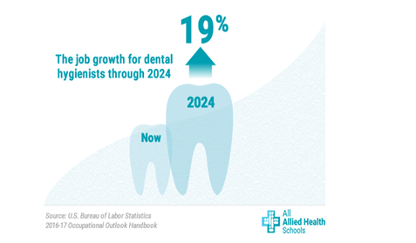
Work outlook
Almost all dental hygienists work in dentists’ offices. A small number of hygienists work in other places such as schools, outpatient clinics or in educational settings .
Dentists often hire hygienists to work part time for only a few days a week.
Stress level is average; occupation flexibility is high allowing hygienists to have an alternative working schedule and work life balance
UCLA Community Oral Health Program
Module 13: Careers in Dentistry

Slide 14
Administrative jobs in dentistry
Dental Receptionist
Dental Office Manager
Patient Care/Treatment Plan Coordinator
Research Assistant/Coordinator
Administrative Assistant
Oral Health Educator
Most of these positions require a general education degree (B.S. or B.A.) or a high school diploma.
You can find job openings at dental offices and university job listing sites.
UCLA Community Oral Health Program
Module 13: Careers in Dentistry

Slide 15
Other Resources
Helpful sites:
Mydentaljobs.com
Google search:
UCLA Health System Careers
UCLA School of Dentistry Careers
UCLA Community Oral Health Program
Module 13: Careers in Dentistry

Slide 16
Thank you!
UCLA Community Oral Health Program
Module 13: Careers in Dentistry

