Slide 1
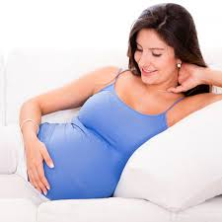
Prenatal Health
Protect both you and your precious baby with a healthy mouth.
Dental care during pregnancy is safe and important!
UCLA Community Oral Health Program
Module 2: Prenatal Health & Transmission

Slide 2
Prenatal Health
Hormone changes may cause your gums to swell, be more sensitive, and bleed easier.
Don’t stop flossing or brushing. Be gentle.
Bleeding and swelling should decrease with time.
Contact your dentist if concerned.
UCLA Community Oral Health Program
Module 2: Prenatal Health & Transmission

Slide 3
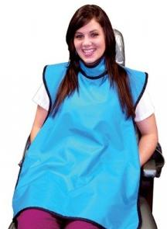
Dental Visits-Prenatal Health
Get dental care. Medi‐Cal covers dental care for pregnant women!
Tell the dentist you are pregnant and your due date.
Most dental procedures are safe:
o Cleanings and fillings
o X‐rays
Ask for a lead apron to cover your stomach and neck.
UCLA Community Oral Health Program
Module 2: Prenatal Health & Transmission

Slide 4
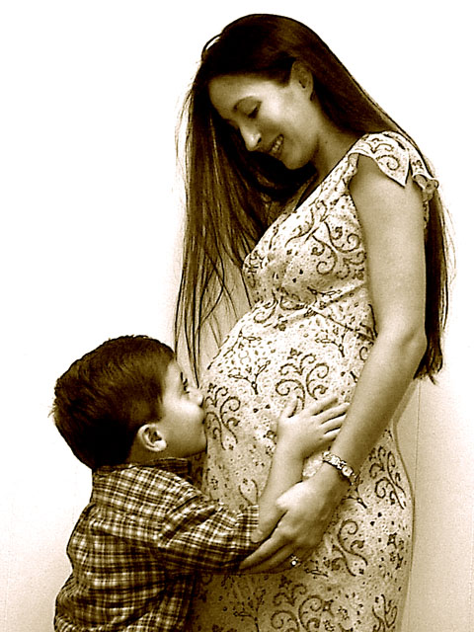
Prenatal Health
You can pass germs that cause cavities to your baby
Parents/Caregivers are the #1 way babies get germs that cause cavities
Moms with healthy mouths have more babies without cavities.
UCLA Community Oral Health Program
Module 2: Prenatal Health & Transmission

Slide 5
Transmission
Source is usually mother
Transmission may occur at birth.
From sharing
UCLA Community Oral Health Program
Module 2: Prenatal Health & Transmission
Notes:
Why is maternal oral health important because caries is contagious

Slide 6
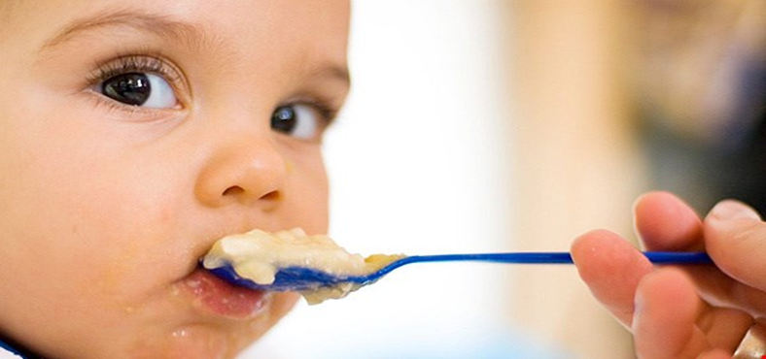
Transmission
When baby begins eating solid foods, do not share your baby’s spoon or food. Bacteria that cause cavities can spread to your baby.
Use your own spoon to test food ‐ and remind others also
UCLA Community Oral Health Program
Module 2: Prenatal Health & Transmission

