Slide 1
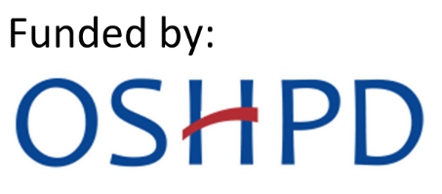
Bottle use & Breastfeeding
Breastmilk is best for your child!
Do not let baby fall asleep with bottle or
breast in mouth.
Milk contains sugar, which can lead to cavities when left on the teeth.
UCLA Community Oral Health Program
Module 6: Bottle Use & Breastfeeding

Slide 2
After bottle or Breast feeding
UCLA Community Oral Health Program
Module 6: Bottle Use & Breastfeeding
Gently wipe gums everyday with a clean
washcloth and water after bottle or breast feeding and at bedtime.

Slide 3
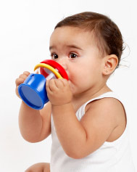
Sippy cup
Introduce sippy cups with tap water at 6 months.
Teach your child to drink from a regular cup by their first birthday.
Give plain water with fluoride, no juice!
UCLA Community Oral Health Program
Module 6: Bottle Use & Breastfeeding

Slide 4
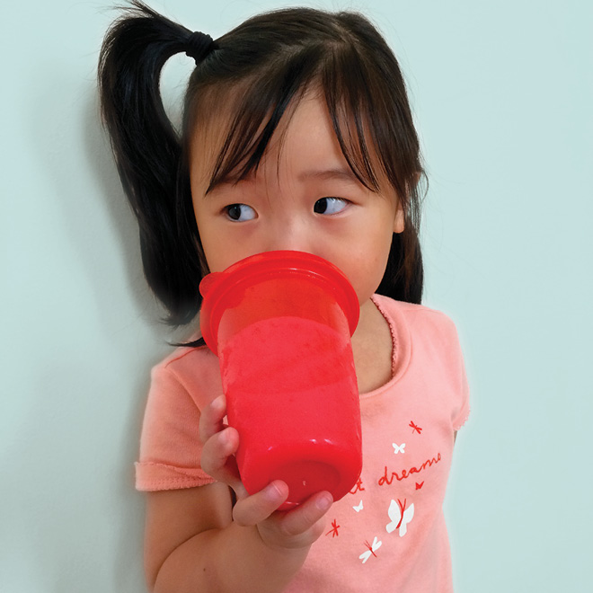
No juice!
Give your child cut-up fresh fruit instead of fruit juice
No sugary drinks like juice and soda!
UCLA Community Oral Health Program
Module 6: Bottle Use & Breastfeeding

Slide 5
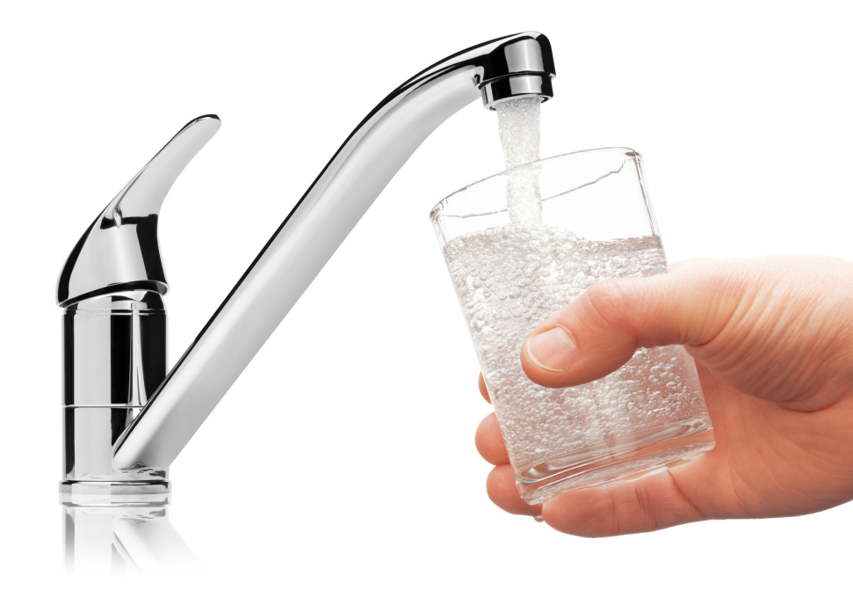
Why is tap water good?
Fluoride in tap water prevents decay!
Bottled water does not usually contain fluoride
UCLA Community Oral Health Program
Module 6: Bottle Use & Breastfeeding
Notes:
Most, but not all, water in the County of Los Angeles is fluoridated. All water in the city of Los Angeles is fluoridated.
Most bottled water does not contain fluoride, look on the label.
If parent’s have concerns about the quality of tap water, ask them to invest in a water filter instead of buying bottled water.

